Slide 1
2023 Colorado Free Application Day$ Instructions

Slide 2
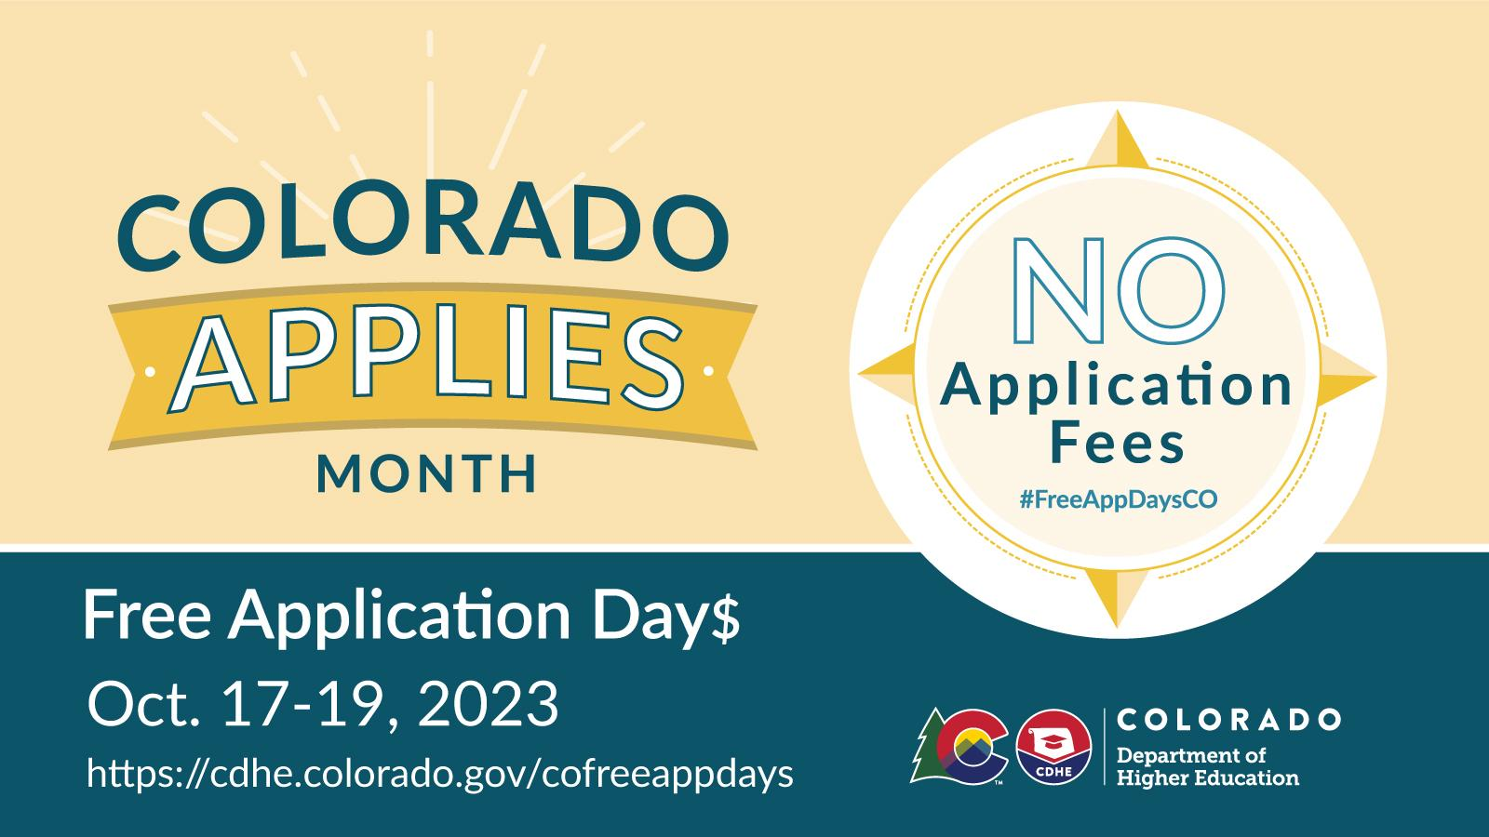

Slide 3
What is Colorado Free Application Day
32 public colleges and universities in Colorado and several private institutions allow students to apply for free as part of the fifth annual Colorado Free Application Day$.
The fee waivers will be valid for applications submitted on Oct. 17-19 only.

Slide 4
Who Is Eligible to participate in Free Application Day
All residents of Colorado who are applying for undergraduate programs at all state public and some private Colorado colleges and universities are eligible to submit their admission applications for free on Oct. 18 - Oct. 20, 2022.
Undergraduate programs include undergraduate level certificates, associate degrees, and bachelor degrees. This means all of the following applicants are eligible:
First-time freshmen
Transfer students
Returning students
Applicants seeking a second bachelor's degree

Slide 5
Community College and Technical Colleges
Colorado community and area technical colleges never charge to apply for admission - its free to apply year round!
No application fee required; applying is free year-round!
Aims Community College
Arapahoe Community College
Community College of Aurora
Community College of Denver
Colorado Mountain College
Colorado Northwest Community
Emily Griffith Technical College
Front Range Community College
Lamar Community College
Morgan Community College
Northeastern Junior College
Otero College
Pickens Technical College
Pikes Peak State College
Pueblo Community College
Red Rocks Community College
Technical College of the Rockies
Trinidad State College
Western Colorado Community

Slide 6
How do I get my application ready?
If you have your sights set on a four-year college or university, you will likely need to submit additional materials and information, including your optional SAT or ACT scores, a personal essay and letters of recommendation.
You must submit a completed admissions application from Oct. 17-19, 2023. Any admissions applications that have been started but not submitted may not be granted a waiver.

Slide 7
Public Four-Year Colleges and Universities
Each public four-year college and university will have a unique fee waiver process.
Some will ask you to submit codes, Others will ask you to select an answer from a dropdown menu, and some have no special instructions or have no fee year-round.

Slide 8
Participating Colleges and Universities
Green= Hyperlinks

Slide 9
Adams State University
No special steps are required for Colorado residents to qualify for Colorado Free Applications days.
Application fee prompts will not appear during this three-day period. Please begin and submit your application during the three days of Free Application Days so that the application fee will not be requested.
Colorado Mesa University
CMU application: The fee will automatically be waived when you submit your application.
Common Application: Students will see the following prompt: Are you eligible for a CMU application fee waiver through one of the following? Choose Colorado Free Application Day in the dropdown.

Slide 10
Colorado School of Mines
Mines’ Golden Application - for First-Year and Transfer Applicants: No special steps are required for Colorado residents to qualify for Colorado Free Applications days.
Common Application - for First-Year Applicants: Within the Mines Member Questions section, you'll see this required prompt:
Do you intend to use one of these school-specific fee waivers?
Select CO Free Application Day (CO residents only) from the drop-down menu.
Colorado State University
Common Application - for Freshman/First-Year Applicants: Choose Colorado Free App EVERY Day (CO high school or address) in the dropdown
Colorado State University Global
When requested, enter the promo code FREEAPPDAY during the application process. Once entered, the application fee will automatically be waived.

Slide 11
Colorado State University Pueblo
Enter the code FreeAppDayCO on the Fee Waiver page of the application.
Fort Lewis College
Applicants applying via our FLC application or the Common App will use the code FREEAPPDAYCO (all caps all one word)
Metropolitan State University of Denver
MSU Denver Roadrunner application (open to all students): No application fee is required; applying is free year-round!

Slide 12
University of Colorado Boulder
Common Application (for first-year, freshmen applicants): Within the CU Boulder Member Questions section, you’ll see this required prompt:
Do you intend to use one of these school-specific fee waivers? Choose Colorado Free Application Days (Colorado residents only) in the dropdown.
Please provide your University of Colorado Boulder fee waiver code here. Enter FreeAppDaysCO in the field provided.Your fee will be waived as long as you submit your completed Common App, Common App personal essay and two short answer questions during Free Application Days. CU Boulder Transfer Application: No special steps are neces
University of Colorado Denver
Milo’s App: On the application page titled Welcome, enter FreeAppDayCO in the application fee waiver code box. As long as you submit on October 17 - 19, 2023 and you are a Colorado resident, you will see the payment waived in your application portal within 24 hours.
Common Application: Within the University of Colorado Denver Member Questions section, answer these two questions like this:
Do you intend to use a school-specific fee waiver? Answer: Yes Please provide your University of Colorado Denver fee waiver code here. Answer: FreeAppDayCO
Your fee will be waived as long as you submit your completed Common App and Member Questions on October 17 – 19, 2023.

Slide 13
University of Colorado Colorado Springs
Common Application (for first-year/freshmen and transfer applicants)
Within the University of Colorado Colorado Springs (UCCS) Member Questions section, you’ll see this required prompt: Do you intend to use one of these school-specific fee waivers? Choose “CO Free App Day 2023” in the dropdown.
Peak Performance Application (for first-year/freshmen applicants – eligible applicants are emailed the link)
When asked how you plan to pay your application fee, select “Mail” and we will waive the fee on our end. UCCS-Specific Application (for first-year/freshmen and transfer applicants)
Link to UCCS Specific Application
When prompted to select a payment method for your application fee, select “Pay by Mail” and we will waive the fee on our end.
Email go@uccs.edu or call 719-255-3084 for any help needed!

Slide 14
University of Northern Colorado
UNC Bear Application:
Within the ‘Fee Waiver’ section, answer these two questions like this: Do you have a University of Northern Colorado app fee waiver code: Answer: Yes, I have a fee waiver code Enter a valid UNC app fee waiver code: Answer: FREEAPPDAYCO
Common Application:
Within our University of Northern Colorado Member Questions section, answer these two questions like this:
Do you have a University of Colorado app fee waiver code? Answer: Yes, I will enter a waiver code Enter a valid University of Northern Colorado fee waiver code. Answer: FREEAPPDAYCO

Slide 15
Western Colorado University
Western Application (for First-year and Transfer applicants):
On the application page titled 'Fee Waiver', indicate that you have a fee waiver code and then enter freeappdayco in the box. As long as you submit Oct. 17 - 19, 2023, you will see the payment waived in your application portal.
Common Application (for First-year applicants only):
Within the Western Member Questions section, you’ll see this prompt: “Do you have a Western-specific fee waiver code”? Choose “yes” in the dropdown menu.
Then you will see: “Please provide your Western fee waiver code here”. In the box type “freeappdayco”. Your fee will be waived as long as you submit your completed Common Application and Member Questions Oct. 17 - 19, 2023

Slide 16
Participating Private Colleges and Universities

Slide 17
Colorado Christian University
When you get to the payment screen, use promo code CCUAppDay to waive the application fee.
Colorado College
No application fee required; applying is free year-round!
Regis University
No application fee required; applying is free year-round!

Slide 18
University of Denver
Common Application:
Within the University of Denver Member Questions section, you’ll see this required prompt: Do you intend to use a school-specific fee waiver? Choose Yes in the dropdown. You will then see another required field:
Please provide your University of Denver fee waiver code here. Enter DUFreeAppDay24 in the field provided. Your fee will be waived as long as you submit your completed Common App and Member Questions on October 17 - 19, 2023.

